Slide 1

GRAPH THEORY AND ITS APPLICATIONS
Dr. Arti Arya
Department of Computer Science & Engineering

Slide 2
GRAPH THEORY AND ITS APPLICATIONS
Graph Applications
Dr. Arti Arya
Department of Computer Science & Engineering

Slide 3

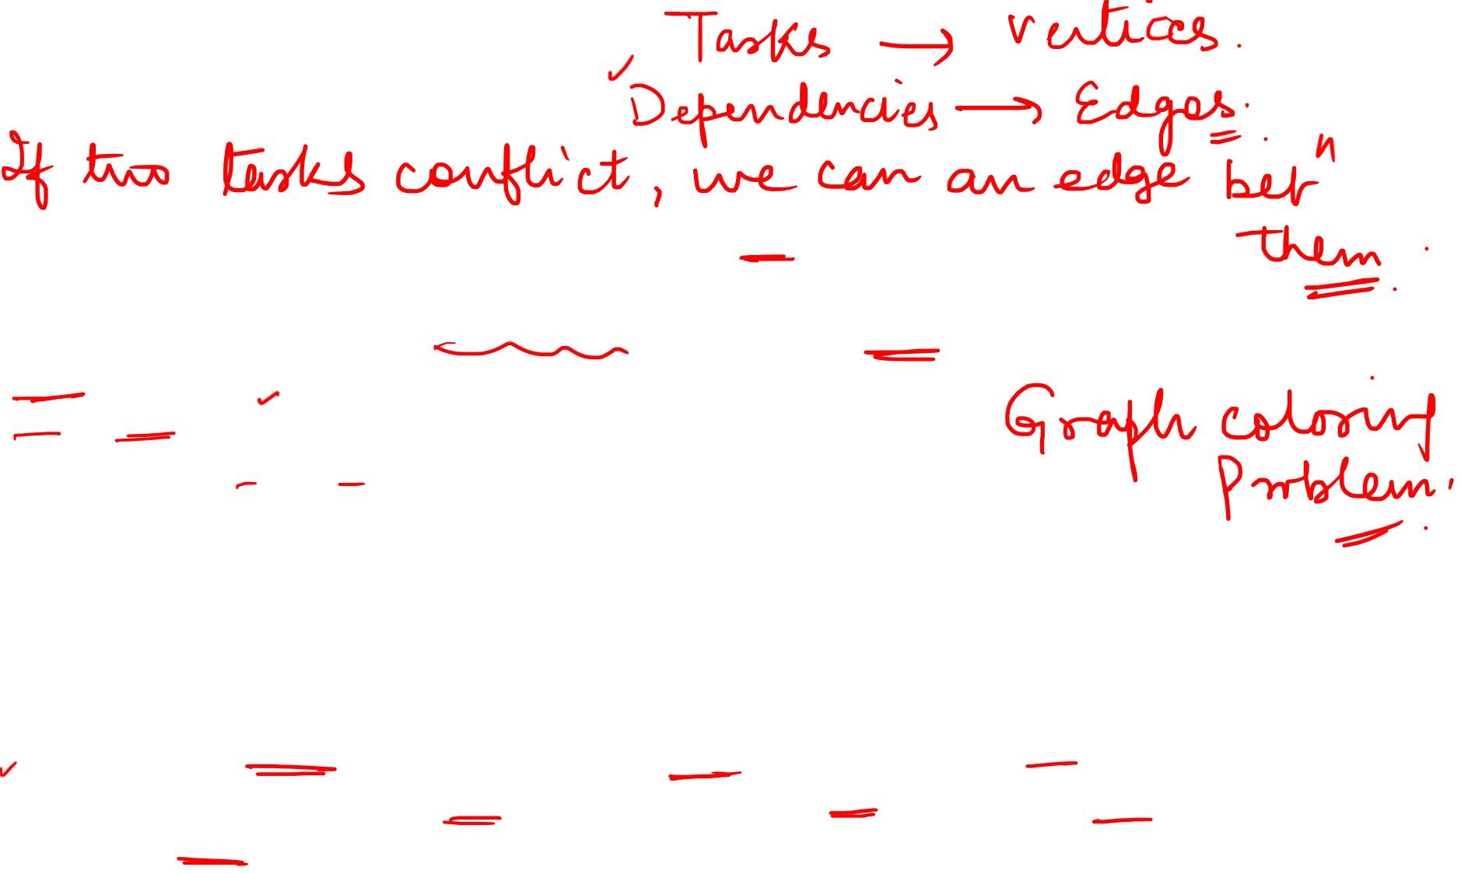
Graph Theory and its Applications Time Table Problem
Suppose we want to schedule final exams for CS courses with the following
course codes: 1007, 3137, 3157, 3202, 3261, 4115, 4118 and 4156.
Assuming that there are no students in common taking the following pair of courses:
1007 – 3137
1007 – 3157, 3137 – 3157
1007 – 3203
1007 – 3261, 3137 – 3261, 3203 – 3261
1007 – 4115, 3137 – 4115, 3203 – 4115, 3261 – 4115
1007 – 4118, 3137 – 4156, 3157 – 4156
1007 – 4156, 3137 - 4118
How many exam slots/days are necessary to schedule exams by considering the courses that are given so that students should not have more than one exams in the same slot/day.

Slide 4
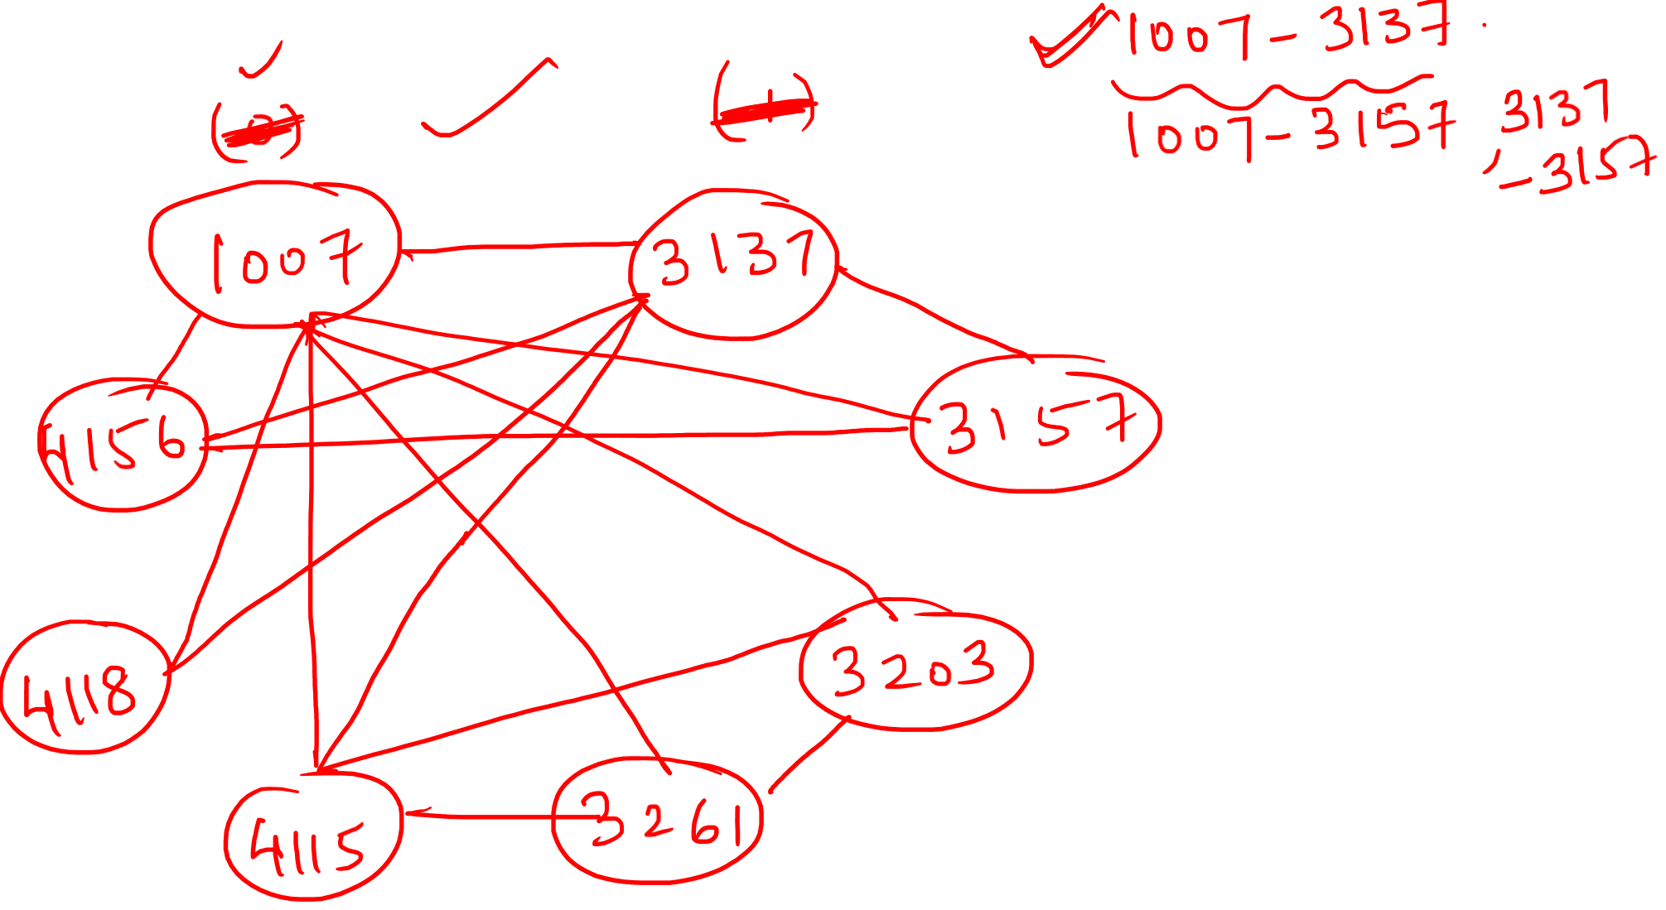

Slide 5
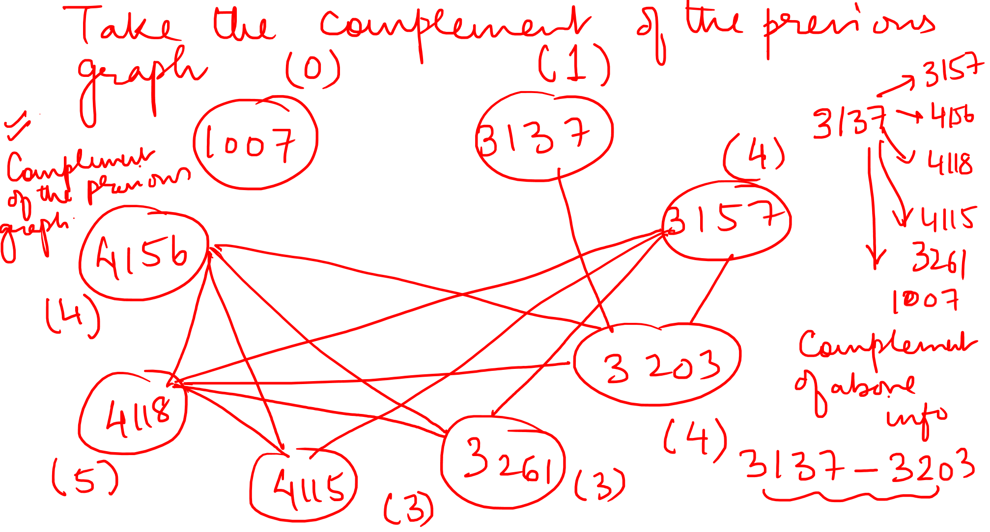

Slide 6
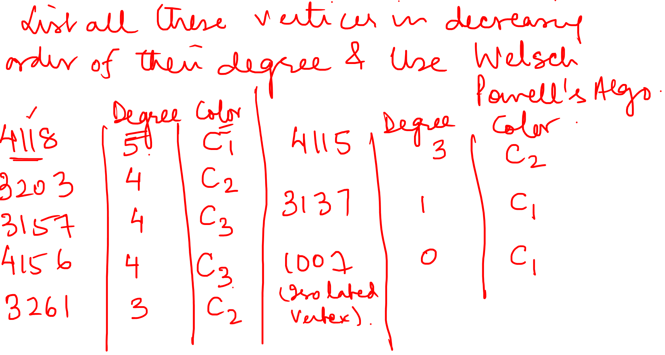

Slide 7
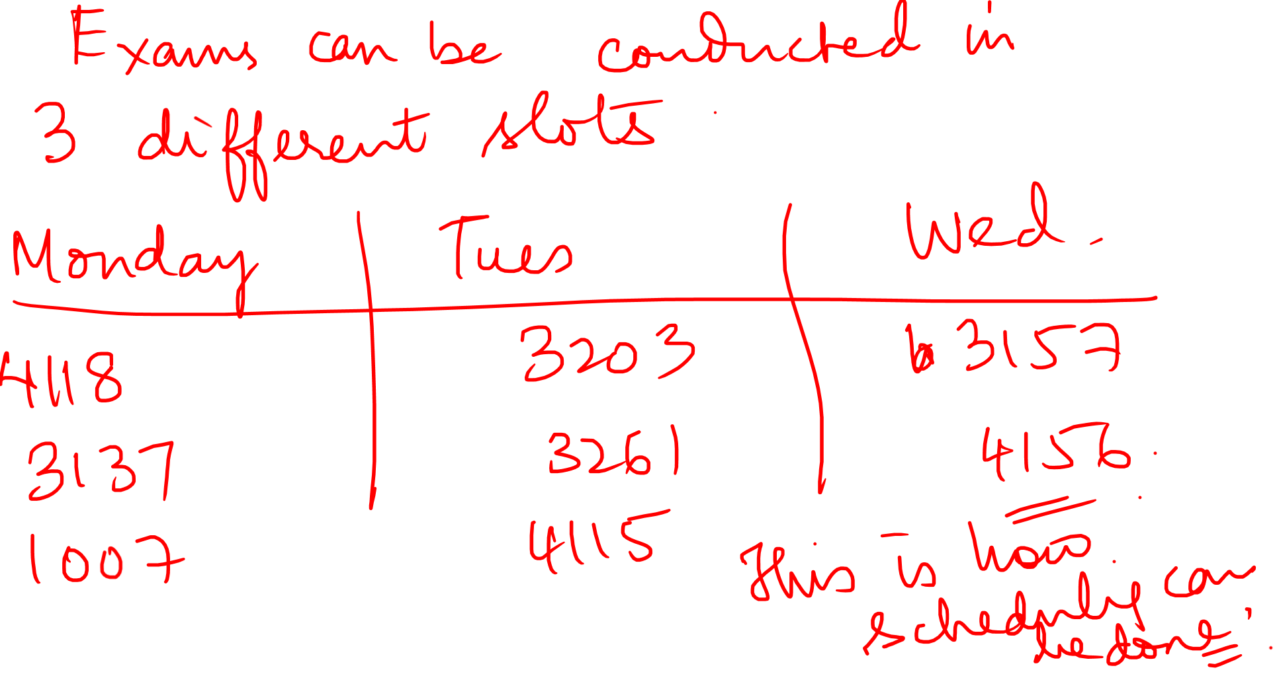

Slide 8
Graph Theory and its Applications Time Table Problem
Exams for the courses A, B, C, D, E, F and G are to be scheduled in minimum number of days. In the table shown ‘ X’ means two courses cannot be scheduled on the same day. How many days are required to schedule the exams. Give one such scheduling.
 | A | B | C | D | E | F | G
A |  | X |  | X | X |  | X
B | X |  | X |  | X |  | X
C |  | X |  |  |  | X | X
D | X |  |  |  | X | X
E | X | X |  | X |  | X
F |  |  | X | X | X
G | X | X | X

Slide 9
Graph Theory and its Applications Time Table Problem
Suppose some university wants to schedule final exams for CS courses with the following course codes: cs1, cs2, cs3, cs4, cs5, cs6, cs7, cs8. Suppose that there are no common students in the following pair of courses
cs1 – cs2, cs1 – cs3 cs2 – cs3, cs1 – cs4 cs1 – cs5, cs2 – cs5 cs4 – cs5, cs1 – cs6 cs2 – cs6, cs4 – cs6 cs5 – cs6, cs1 – cs7 cs2 – cs7, cs1 – cs8 cs2 – cs8, cs3 – cs8

Slide 10
THANK YOU
Dr. Arti Arya
Department of Computer Science &Engineering

